Slide 1
BRASS: Building Resource Adaptive Software Systems
Suresh Jagannathan, I2O
April 8, 2015
Distribution Statement A - Approved for Public Release, Distribution Unlimited

Slide 2
Agenda
1230 – 1300 Check-In/Registration
1300 – 1315 Welcome Suresh Jagannathan, DARPA
1315 – 1345 Contracts Michael Blackstone, DARPA
1345 – 1430 BRASS Overview Suresh Jagannathan, DARPA
1430 – 1500 Attendee Presentations
1500 – 1600 Break
1600 – 1700 Government Response to Questions Suresh Jagannathan, DARPA
Distribution Statement A - Approved for Public Release, Distribution Unlimited

Slide 3
Logistics
DARPA-BAA 15-36
FedBizOpps website (http://www.fedbizopps.gov)
Grants.gov website (http://www.grants.gov)
Posting Date: April 7, 2015
Proposal Due Date: May 22, 2015 at Noon ET
Attendee Presentations
Two minutes in length and a single content slide
Slides are pre-loaded on laptop
Government Response to Questions Session
Questions can be submitted until 3:30pm to BRASS@darpa.mil
Questions will be answered during Q&A session
Online Material
Program Page: http://www.darpa.mil/Our_Work/I2O/Programs/Building_Resource_Adaptive_Software_Systems_(BRASS).aspx
Copy of Government Presentations
Video of BRASS Overview Presentation
Frequently Asked Questions (FAQs)
Teaming site: https://www.schafertmd.com/darpa/i2o/brass/teaming/
Distribution Statement A - Approved for Public Release, Distribution Unlimited

Slide 4
Understanding an application’s environment
Abstractions
Program Analysis
Monitoring, Instrumentation,
Dynamic Translation, VMs
Relax: expose timing faults to software to improve error tolerance with lower power
Green: Online monitoring and QoS for approximate computing of loops and functions
EnerJ: Type system that isolates parts of the program that must be precise from those that can be approximate
PetaBricks: Autotuning abstractions that extends notions of algorithmic choice with support for selection of variable accuracy algorithms
Coccinelle: A DSL for describing semantic patches in collateral evolution of Linux device drivers
Self-adjusting computation: Identify notion of changeable computations that respond to changes in input
Bi-directional programming and lenses: Maintain semantic consistency between related sources of information
Pyxsis: Offloading computation from Java applications to SQL database server for improved performance
RAML: A first-order dialect of ML that supports a multivariate amortized analysis that computes polynomial resource bounds
Terminator and T2: Automatic verification tool for proving termination and liveness properties in CTL
Resynth: Automated refactoring tool using program synthesis
Cache and I/O Efficient Functional Algorithms: A cost model for analyzing the memory efficiency of algorithms expressed in a functional language
CodePhage: Automatic transfer and patching of correct code from donor applications intro recipient applications to eliminate errors
HalVM and MirageOS: Haskell and Ocaml-based unikernels running on Xen
Digital Vellum: Cloud storage in which every file is bundled with information
Drawbridge: Virtualization support for application sandboxing using a library OS
Lancet: Surgical precision JIT compiler with metaprogramming support
Kitsune: A dynamic software update system for C capable of whole-program updates
REFRACT: Failure avoidance through adaptive reconfiguration
Naid: Timely dataflow as a computational model for scalable Big Data analytics of changing data at interactive timescales
Types, Semantics, Verification
Symbolic Execution
Battery Transition Systems: Formal model of energy systems with recovery effect behavior | CompcertX: Language-based account of abstraction layers and implementation independence properties
Session Types: Type systems for expressing communication protocols | Data description languages: DSLs and type systems for expressing the structure and representation of ad hoc data formats
CALM: Consistency as logical monotonicity for reasoning about eventual consistency | Separation Logic: Program logic for verifying properties of dynamic data structures and the heap
Vault: Linear type system to track memory ownership and resource management | Assume Guarantee Reasoning: Automated compositional verification of complex systems
KLEE: Symbolic execution engine to generate high-coverage test cases
S2E: Scalable path-sensitive platform
Distribution Statement A - Approved for Public Release, Distribution Unlimited

Slide 5
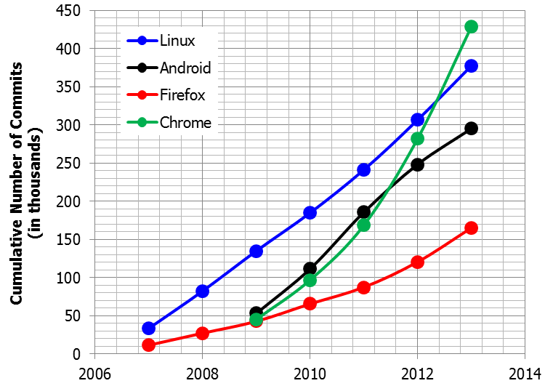
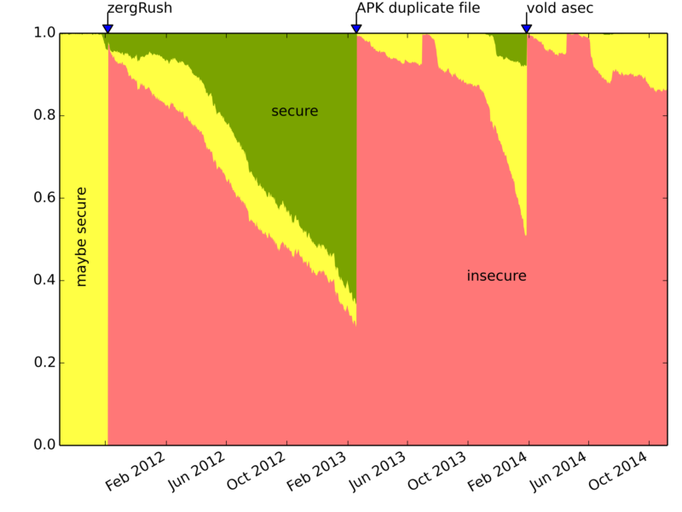
Software Change and Vulnerability
Proportion of Android devices running insecure, maybe secure, and secure versions of Android over time
Source: openhub.net
Source: androidvulnerabilities.org
Past 12 Months
 | Files Modified (in thousands) | Lines Modified (in millions)
Linux | 34 | 82
Android | 80 | 26
Firefox | 83 | 50
Chrome | 120 | 23
Nearly every U.S. weapons program tested in fiscal 2014 showed “significant vulnerabilities” to cyber attacks, including misconfigured, unpatched and outdated software, the Pentagon’s chief weapons tester said in his annual report.
- Reuters.com, Jan. 2015
“The [in]ability to preserve and run software over long periods of time may make the 21st century an information black hole.”
- Google VP Vint Cerf, Feb. 2015
Source: openhub.net
Distribution Statement A - Approved for Public Release, Distribution Unlimited

Slide 6






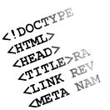
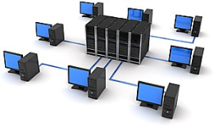


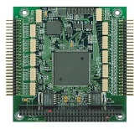



Problem
Logical Resources
(libraries, data formats, structure)
Physical Resources
(energy, storage, processing, OS)
Source: iconfinder.com
Source: fotolia.com
Source: reusetek.com
Source: imgarcade.com
Source: youtube.com
Source: compucentro.info
Source: firstonesystems.com
Source: olx.in
continuous
discrete
Resources Change Unexpectedly or Intentionally
(e.g., failures, upgrades, patches)
?
Source: iconfinder.com
Source: grihaindia.org
Source: eurotech.com
Source: imgarcade.com
Source: ibncindia.com
Source: compucentro.info
Source: openup.com.uy
Source: cs.cmu.edu
Functionally correct code may operate incorrectly or inefficiently,
as the operational environment in which it executes changes
Distribution Statement A - Approved for Public Release, Distribution Unlimited

Slide 7
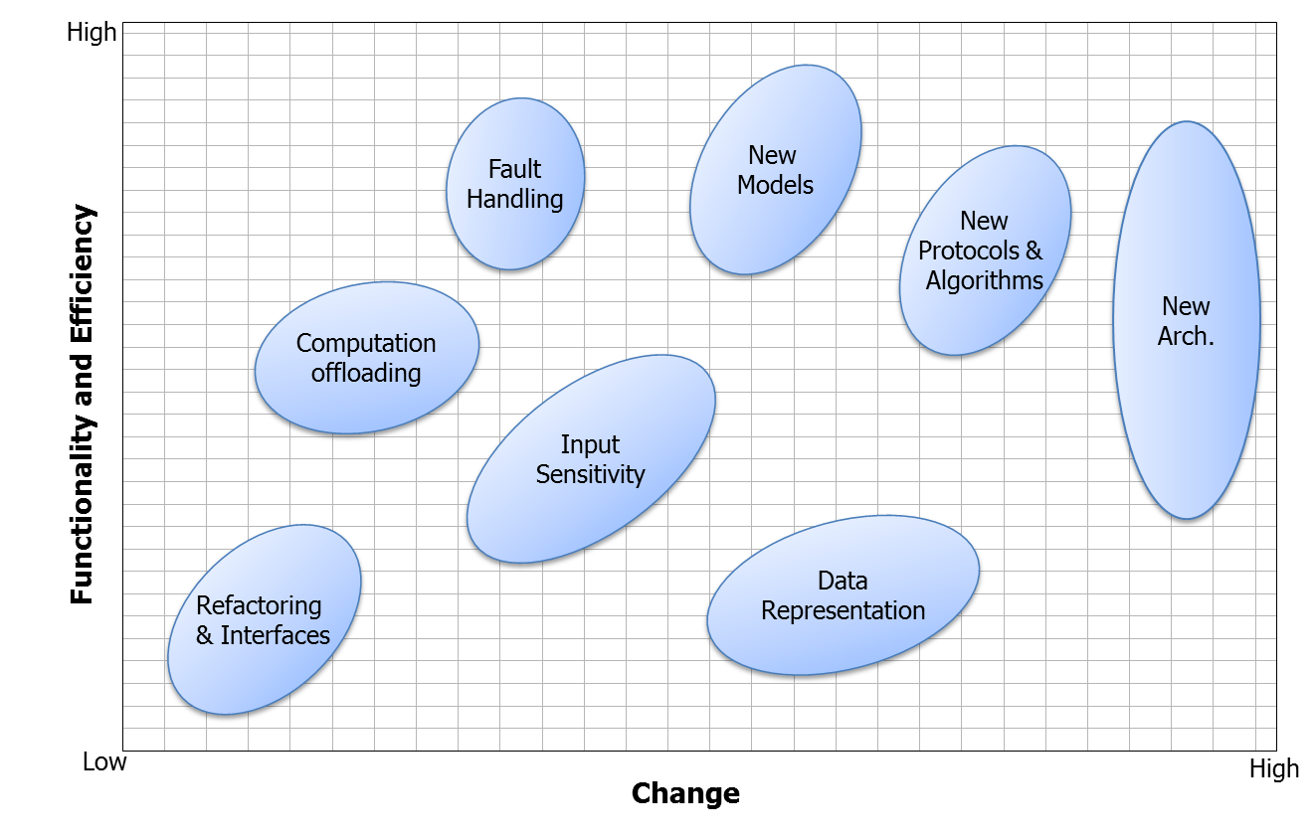
Functionality and Change
Restricted Functionality
Physical resources (energy, memory, network, communication)
Restricted policies (security)
Enhanced Functionality
Protocols and runtime services
Cross-language interoperability
Altered Functionality
Computation and memory models
Data formats
Distribution Statement A - Approved for Public Release, Distribution Unlimited

Slide 8
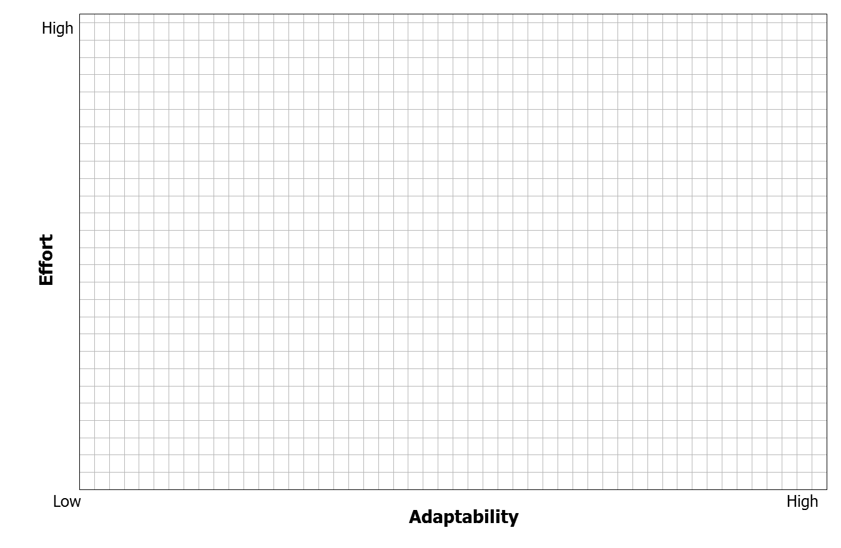
Goal
Certified/Verified System
QoS
(e.g., RTOS)
Autonomy
Protocols
Distributed Algorithms
Security
Virtual Machine (e.g., VMware)
Cloud
Autonomic
Systems
Compilers
Managed Languages (e.g., Java)
Goal
Unmanaged Languages (e.g., C)
Operating Systems
Distribution Statement A - Approved for Public Release, Distribution Unlimited

Slide 9
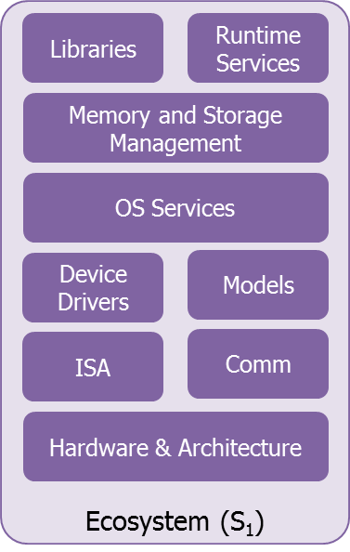
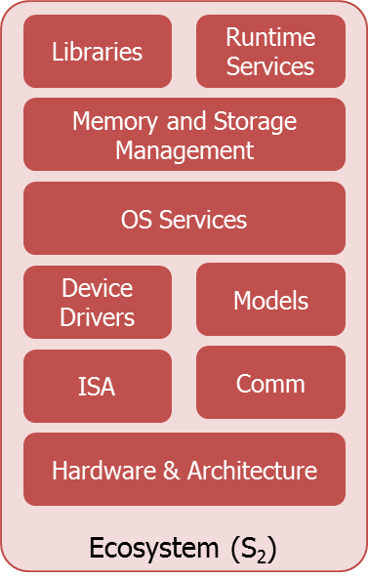
Idea
Q₂
Q₃
P₂
P₇
Q₁
P₁
P₃
Domain driven
P
P
P₈
P₄
P₉
P₅
High fidelity between P and P_{j}
dictated by
Functionality
Correctness
Efficiency
Performance
P₆
P_{j}
Q₄
Q₅
discrete
continuous
Distribution Statement A - Approved for Public Release, Distribution Unlimited

Slide 10
Idea
UIs
IDEs
Brower
Application
Compiler
Databases
Runtime Services
Libraries
Memory and Storage Management
Operating System Services
Models
Device Drivers
Comm
ISA
Hardware and Architecture
Distribution Statement A - Approved for Public Release, Distribution Unlimited

Slide 11
Architecture
Programs
Discovery
Compiler
Analytics
Abstractions
Monitoring & Profiling
Analysis
Adaptive
Variants
Error & Cost Models
INTENT
TRANS.
Runtime/VM
Semantics
Selection & Transformation
Testing
Validation
Models and Specifications
Evolving Ecosystems
Platform APIs
Platform
Distribution Statement A - Approved for Public Release, Distribution Unlimited

Slide 12
Program Structure
Technical Area 4:
Evaluator
Technical Area 1:
Platform
Domain Experts
Technical Area 2:
Analytics
Programming Language, Compiler, Runtime, Operating System, and Formal Method Experts
Technical Area 3:
Discovery
Distribution Statement A - Approved for Public Release, Distribution Unlimited

Slide 13
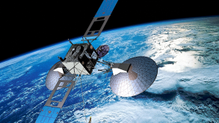



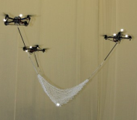
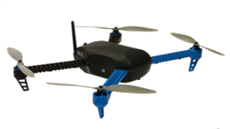

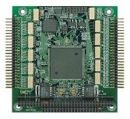

TA1: Platform
Exemplar platforms include, but are not limited to
Autonomous and robotic systems
Embedded systems (e.g., Internet of Things)
Geo-distributed systems
Heterogeneous scalable multiprocessors
Cloud infrastructure
Mobile computing
High-assurance systems
Coordinated platform (i.e., Swarm)
Storage and file systems
Diverse hardware infrastructures (e.g., FPGA)
Source: darivoa.com
Source: www.forum.eideha.com
Source: adrotelecom.nl
Source: cs.cmu.edu
Source: ibm.com
Source: flagvruki.com
Source: HACMS
Source: cisco.com
Source: eurotech.com
Source: blog.randahl.dk
Source: reusetek.com
Distribution Statement A - Approved for Public Release, Distribution Unlimited

Slide 14
TA3: Adaptive Front-End Discovery
Programs
Abstractions
Resource
Aware
Variant
Platform
Assumptions
and domain
knowledge
Ecosystem
Types
Model checking
Theorem proving
Abstract Interpretation
Runtime verification
Contracts and assertions
Documentation analysis
Models
Analysis
Clients
Testing
Specifications
Intent
Compiler and
Runtime
Distribution Statement A - Approved for Public Release, Distribution Unlimited
Notes:
- The analysis component leverages advances in a number of areas, as illustrated in the box. Its result is a set of assumptions on resource behavior as determined by its interaction with reference/original system S1. This set is captured within the representation defined by the idealized abstract system. A number of techniques [ cite elements in the boxes ] will be used to produce the IAS.

Slide 15
TA2: Adaptive Back-End Analytics
Upgrades
Patches
Migration
Fuzzing
Mission Parameters
Platform
Ecosystem
Instrumentation
Programs
Monitoring and
Profiling
Validation
Selection and Transformation
Error and
Cost Models
Dynamic Updates and Patch Injection
Metaprogramming and
JIT compilation
Versioning
Mining
Snapshotting
Machine Learning and
Optimization
Synthesis and
Computation
Offloading
Distribution Statement A - Approved for Public Release, Distribution Unlimited
Notes:
- The analysis component leverages advances in a number of areas, as illustrated in the box. Its result is a set of assumptions on resource behavior as determined by its interaction with reference/original system S1. This set is captured within the representation defined by the idealized abstract system. A number of techniques [ cite elements in the boxes ] will be used to produce the IAS.

Slide 16

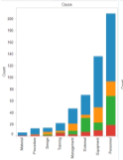
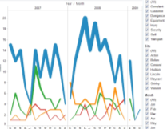



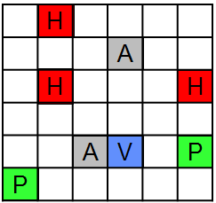



TA4: Evaluator (not solicited)
Virtual Machine Disk Image
Application
Performer Stack
Performer Deliverables
T&E Services
Optional Services
Operating System
Database
…
Libraries
File System
API
T&E Evaluation Framework
Network
Emulation
Frameworks
Metrics
Gathering
Perturbation
Engine
Virtual
Hardware
Challenge
Problems
Sensors
Source: MIT/LL
*Notional
Distribution Statement A - Approved for Public Release, Distribution Unlimited

Slide 17
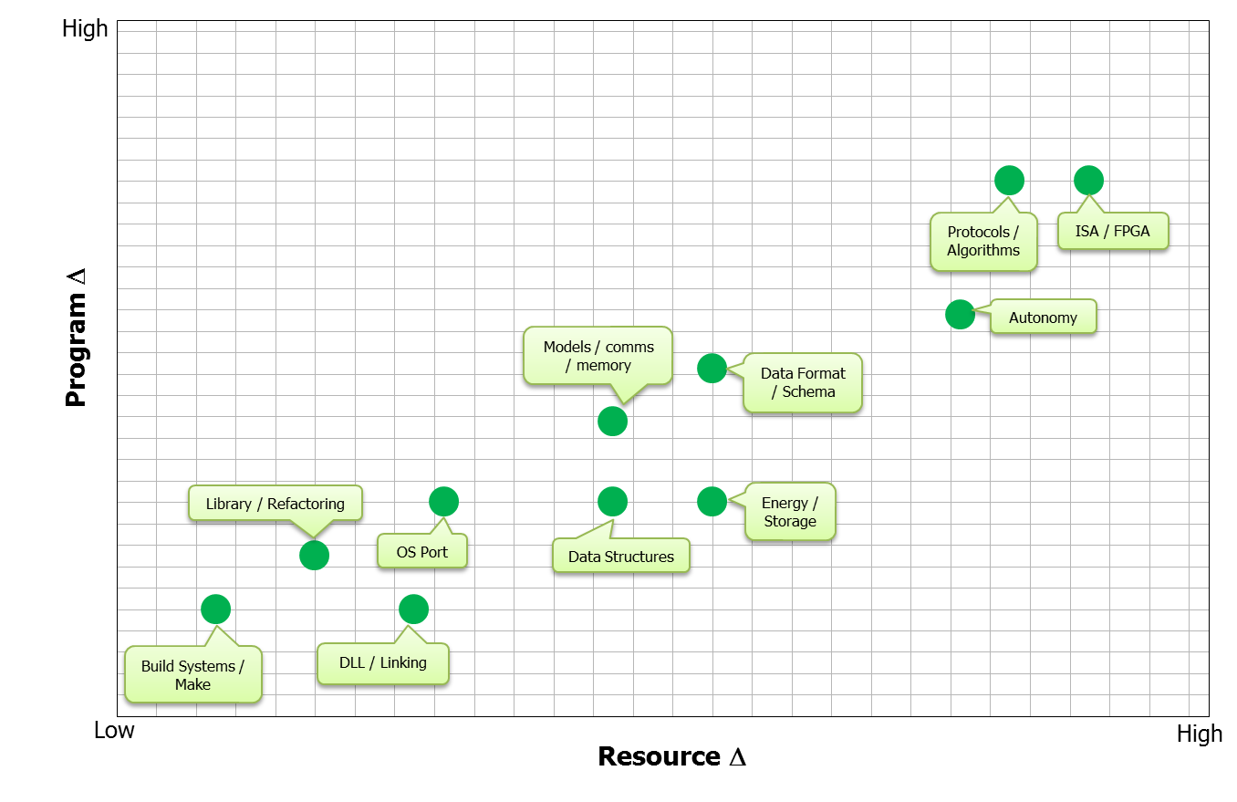
If this technology is wildly successful…
Phase 3
Phase 2
Phase 1
Distribution Statement A - Approved for Public Release, Distribution Unlimited

Slide 18
Schedule, Products, & Transition Plan
Products
Fully adaptive platforms
Adaptive monitoring and transformation tools
Continuous resource adaptive analysis suite
Transition Plan
Include Government customers involved in related domains on challenge program selection and encourage participation in “Platform Demos”.
Distribution Statement A - Approved for Public Release, Distribution Unlimited

Slide 19
Overall Programmatics
Three 16 month Phases
Four Technical Areas (TAs)
TA1 - Platform
TA2 - Analytics
TA3 - Discovery
TA4 - Evaluator (not solicited)
Anticipate multiple awards in TAs 1, 2, and 3
The TA4 (Evaluator) will be provided by the Government and proposals for this area will not be solicited under this announcement
Anticipated award amount for an integrated TA1-3 effort will range between $8-$10M
Performers in TA1-3 will be grouped into one design team
Each team led by a TA1 performer
Each team will have one TA2 performer and one or more TA3 performers
Each team will produce a working end-to-end Discovery and Analytics System (DAS)
Teams will not be competitively evaluated; no anticipated down-selection
Strong interaction among all performers is critical to program success
Associate Contractor Agreement (ACA)
Distribution Statement A - Approved for Public Release, Distribution Unlimited

Slide 20
TA1 Programmatics
Lead a DAS design team
One TA2 performer and one or more TA3 performers
Produce a working end-to-end DAS
Provide Platform/Domain knowledge to DAS design team
Interaction with TA2 and TA3 performers
Educate them about the technical challenges in producing resource adaptive versions of the platform
Develop unrestricted and unclassified Platform-Specific Challenge Problems
Apply their team’s research results to the development of a working end-to-end DAS
Coordinate and finalize definitions of APIs, interfaces, representations, internal DSLs, and other technologies necessary to enable interaction among their team
Interaction with the Evaluator
Propose two Platform-Specific Challenge Problems two months after the program kick-off and three Platform-Specific Challenge Problems two months after the start of Phase 2 and Phase 3
Finalize the Platform-Specific Challenge Problems by the PI meeting in each Phase
Deliver the DAS for evaluation two weeks prior to each Platform Demonstration Workshop
Serve as the primary POC for technical support during the evaluation of the DAS
Demonstrate the DAS on the Platform-Specific Challenge Problems at each Platform Demonstration Workshop
Initiate discussions on proposed Platform-Specific Challenge Problems for the following phase
Work with the Evaluator to define an API between the DAS and the Evaluator’s evaluation framework
It is strongly preferred that the identified platforms, including sensors, computing hardware, and software, are unclassified.
Distribution Statement A - Approved for Public Release, Distribution Unlimited

Slide 21
TA2/TA3 Programmatics
Participate in one DAS design team, led by a TA1 performer
Use the Platform-Specific Challenge Problems developed by the partnered TA1 performer to evaluate and drive research
Deliver appropriate code and documentation to their partnered TA1 performer at regular intervals, and on a schedule consistent with the delivery of a working DAS three weeks before each Platform Demonstration Workshop
Work with performers from all TAs to identify critical research challenges and issues
TA2 and TA3 proposals that are not part of a collaborative TA1 effort must nonetheless clearly justify the utility of their approach in the framework of a potential platform.
Distribution Statement A - Approved for Public Release, Distribution Unlimited

